Slide 1

Notes:
Thank you all for taking time to join us today for a conversation about our work and our future.

Slide 2

The Foundation:
A New Vision
+ Where We Are

Slide 3
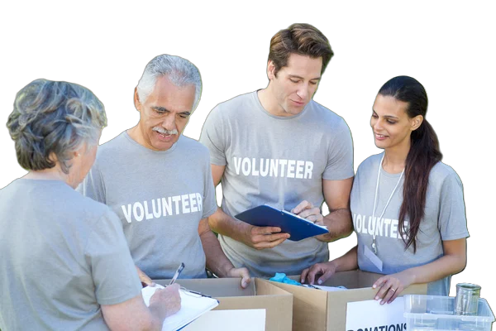

section 1
What makes a
healthy community?
Notes:
As employees in a local public health department, we too often focus on our work. Our daily tasks. Our program customers. Our tiny bit of the big picture, and that can feel like a lot most days.
But step back from your job – your function in the department – and yourself the big question: how do we create and maintain healthy communities? What does that look like? How do we define it? How do we affect it? How do we know if we’re achieving it, or whether we need to change our focus or approach to it?
** This is a discussion slide. Engage staff in what they think a ‘healthy community’ includes, or is defined by, or how it’s determined.

Slide 4

section 2
What’s our top challenge?
+
Staffing?
+
Funding?
+
Culture?
+
Service?
+
Politics?
Notes:
Everyone has thoughts on what our top department challenge is. If you could bring change to the one thing you think is our department’s top challenge, what would be the thing you would address?
Staffing?
Funding?
Culture?
Service?
Local politics?
State politics?

Slide 5
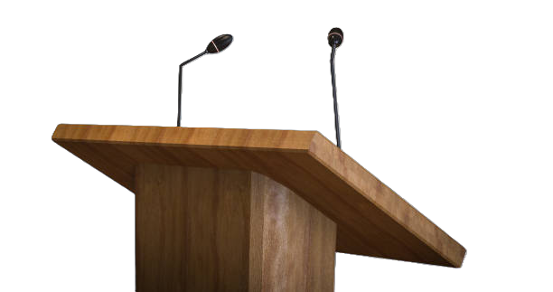
section 3
The Public Understanding Challenge
Many residents became aware of public health work during the pandemic, and those experiences shaped lasting perceptions.
Notes:
Post-pandemic public health is in an interesting position throughout the state and the nation. Before the pandemic, most people in a community didn’t have a clear understanding of our work, and that was okay. The aspects of our job they became familiar with during the pandemic shaped a public perception. For many, that means strong negative emotion based on a very limited recognition of what we do.
The biggest issue contributing to all our challenges is inconsistent success connecting with our community, telling our story in ways people understand, and demonstrating our broad value to the local leaders who help determine our fate, based on the big picture outcomes of our work.

Slide 6

section 4
A New Vision for an Old Challenge
The new vision for public health is about proactively addressing long-standing health issues in our communities, instead of reactively treating health problems that are preventable.

Slide 7
New Vision for Public Health
in Michigan
Finalized Nov. 2025
Notes:
This vision was shaped through collaboration and shared leadership across the state. A meeting held in March 2024 with state and local public health leaders sparked the development of this framework, grounding it in the real challenges and opportunities facing communities today. Since then, feedback has been gathered from hundreds of individuals across the state, including health officers and MALPH forums, ensuring the vision reflects diverse perspectives and a collective commitment to advancing Health for All.
Health is shaped by policies, environments, and daily conditions - not just health care. By advancing a Health in All Policies approach and improving public understanding of public health’s role, Michigan can build trust, increase visibility, and create lasting support for prevention and wellbeing.
Together, this work positions Michigan to lead with a public health system that is resilient, responsive, community-centered, and prepared for the future - ensuring every community has the foundation it needs to thrive.
Health in all Policies (HiAP) is a collaborative approach that emphasized the importance of considering health implications in public policies across different sectors, such as transportation, education, housing, and agriculture. Learn more at Health in All Policies.

Slide 8
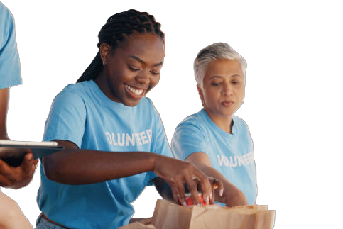
section 5
Public Health is a Community Effort…
… and what does our
community connection
look like today?
Notes:
Strategic Priority: Strong community engagement and cross-sector partnerships
Taking a more proactive stance in our work requires recognizing how much of creating healthy communities falls on the shoulders of others in the community.
Within public health, we have our annual community assessments. They cover public health programs we work on.
But we’re not alone in this, are we? Consider the factors to a healthy community we don’t control directly – like access to housing, healthy food, education, safe streets, emergency response services, transportation, and more. These are key factors in long-term health outcomes.
If we spent some time as a group, charting all those who have some hand in the outcome of “healthier community” are we working closely with them? Schools, law enforcement, the housing industry, leading job providers, county and township leaders, Emergency managers, grocers … how are we doing? How could we do it better? How can we connect with those who have a role and may not even think of their work as contributing to the broad outcome of public health?

Slide 9
The Together for Health Campaign
MALPH + LHDs’ + partners’ role in modernizing public health in Michigan

Slide 10
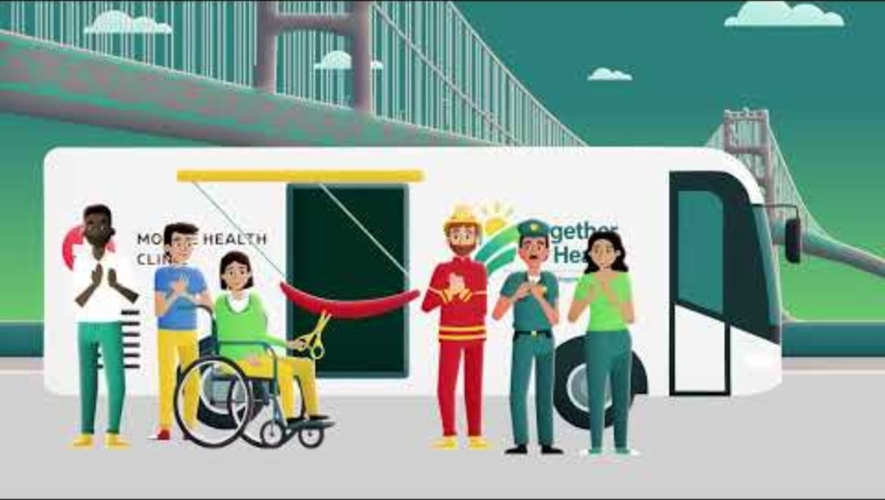
Notes:
Play the 2-minute animated Together for Health explainer video.
This is an embedded video from YouTube. Link: https://www.youtube.com/watch?v=lMVNzpMMuhU. Let Gwen [gtithof@malph.org] know if an mp4 file will work better for you.

Slide 11
section 6
What Is This Campaign About?
Developing and strengthening local partnerships with entities that support or are part of our mission
Promoting our work in terms people can understand and support
Lobbying for sustained, stable funding for our work in the years ahead, based on strengthened support from activated partners at the local, state, and regional level
Generating excitement about our work within our customer base and local community leadership
Notes:
Right now, you’re probably thinking, “that was a pretty cool video, and it did make me feel good about what public health does for my community. But what is this campaign trying to do, and how am I part of the thing?”
Here’s how to think about it.
There are people in our community whose work each day determines the overall health of our neighborhoods, and they don’t even realize they are part of public health.
There are people struggling in our towns right now, and they’re unaware there are programs that could help them live better.
There are local leaders around us who, if they understood our work better, would become our champions instead of being ambivalent toward us.
This is a campaign about raising up a banner everywhere around the state with a unified, simple, compelling message about who we are and why we are worth supporting.

Slide 12




Key Pillars of T4H
Public Health Works – When the System Works
Visibility Builds Trust
Strong infrastructure, clear tools, and skilled people lead to measurable community impact
Coordination and shared priorities prevent gaps and duplication
When communities see public health in action, they become partners in prevention
Data, technology, and quality improvement ensure accountability and adaptation
Funding People = Protecting Communities
Flexible, inflation-adjusted funding sustains progress
Investing in the workforce builds resilience and readiness
Every Community Deserves This
Health is Built Everywhere
Strong public health is essential.
Everyone has a role, and no one is left behind.
Housing, transportation, education, and economic decisions shape health
Health in All Policies strengthens outcomes across sectors
Notes:
Strategic Priority: Community Valuing and Understanding of Public Health requires us to focus our message and speak in different ways.

Slide 13

section 7
Localizing the Campaign
Shared tools
Shared data
Shared successes
Consistent, clear messaging

Slide 14
section 8
Every Employee Has a Role
Using shared tools, data, and messaging consistently
Health is built everywhere: our community conversations needs to connect those dots
Highlighting local wins and system impacts
Alignment = a unified effort between all local health departments
Notes:
The campaign web site tells our story in relatable ways. Our job at the local level is to take the time to make sure the people we each touch, no matter our departmental role, are aware of this campaign’s messages and themes. It can be as simple as putting the campaign web address and tag line in your email signature block. It can be as involved as going to a public meeting of a chamber or rotary and doing a short presentation about the Together for Health campaign and what it means.
This effort focuses on the fact that health is built in housing, education, transportation and economic conditions, not just in health departments. It is an ecosystem lens, and everyone is part of the ecosystem.
Aligning our storytelling as local public health departments helps us consistently connect those dots around the state.

Slide 15
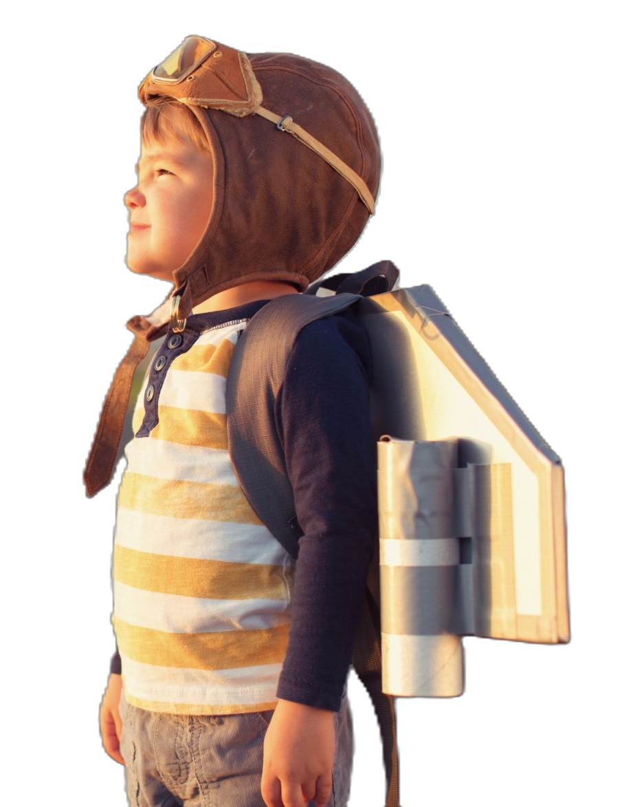
section 9
Measuring Success
Notes:
People can’t know us by the tasks we perform. They will know us, appreciate us, and support us by the outcomes we create: Local public health is the local leader on efforts to create places where people live longer, healthier, happier lives. We are the hub, connecting with other community groups like spokes on a wheel, delivering important service connections; we are leading the conversation about what our communities need to be better; we are moving services and resources to people who need them, either directly or by connecting people in need with our partners to help them.
I’m not asking anyone to do their job differently. I’m inviting you to help tell our story more effectively, and join an effort that will bring greater public understanding of how critically important out work is. When people understand what we really DO, they support it. And when more people understand and support it, our needs become the community’s needs. The annual scramble to secure stable funding gets easier, because our role is known and our value is inarguable.
We will know this campaign is successful when we see its results all around us.

Slide 16
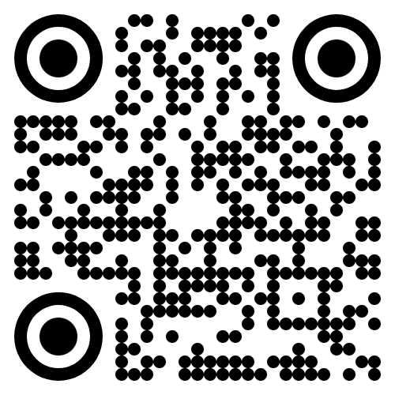
There is a toolkit. And it is cool.
togetherforhealthmi.org
Notes:
Our PIO and comms team will get a separate training session about how to mobilize the Together for Health campaign elements. You’ll see them on our social media. You’ll see them on our web page. We want to find ways to see them everywhere.
The toolkit is a treasure chest of resources to help provide consistent storytelling about what we do and why we matter. It’s about how we promote this campaign within our community at every level we touch – customers, partners, and leaders in business, civics, religion, etc.

Slide 17

Closing Reflection

Slide 18

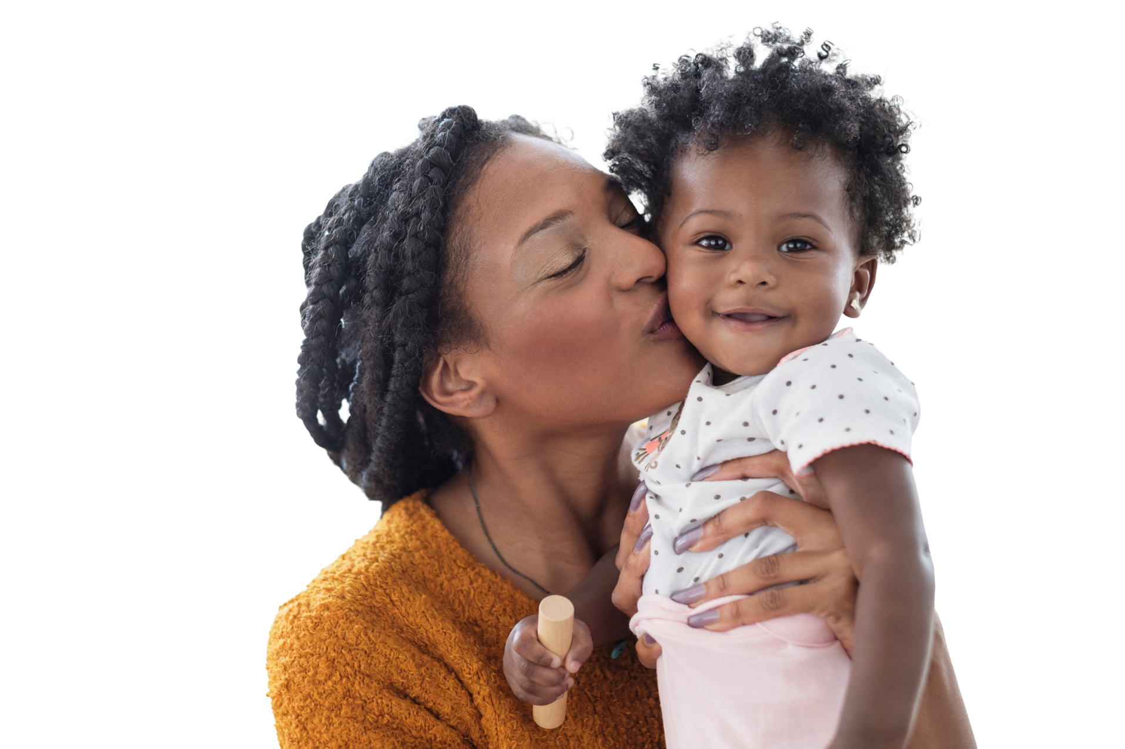
Thank You
for Participating!
Together for Health in Michigan
malph.org
togetherforhealthmi.org

